Slide 1
Video Game Sales Data Analysis
By: Faizan Virani

Slide 2
Data source
Dataset (vgsales.csv) was obtained from the website kaggle.com. The dataset was uploaded 4 years ago, and was posted by user “GregorySmith”. Sales from over 16,500 games were analyzed

Slide 3

Tools Used
Python
MatPlotLib
Pandas
Seaborn
Numpy
Kaggle
Jupyter Notebook

Slide 4

Questions
What video game genre is the most popular?
What video game platform has the most games?
What is the average percent of total sales which are from the US?
What year had the most popular games released?
How do Japanese sales compare to European sales on average?

Slide 5
Data Points
Rank
Name
Platform
Year
Genre
Publisher
NA_Sales
EU_Sales
JP_Sales
Other_Sales
Global_Sales

Slide 6
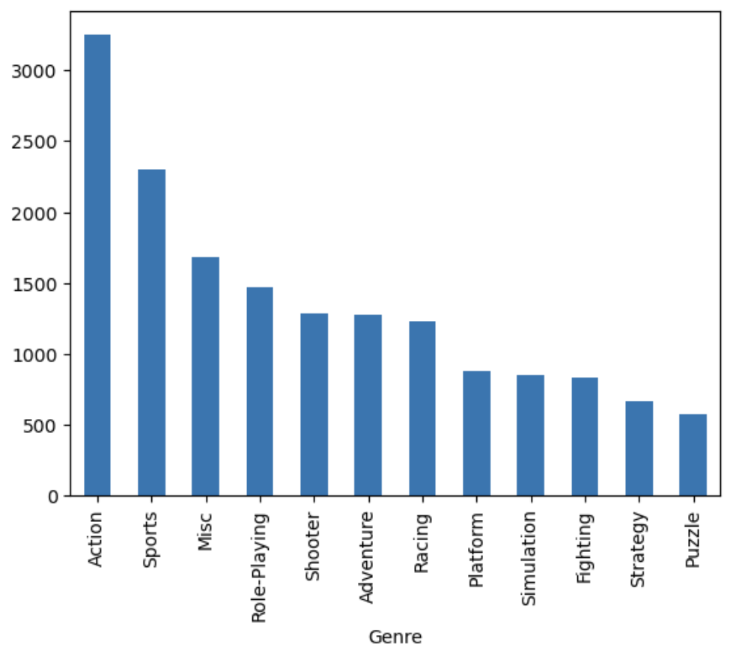
Question 1
What video game genre is most popular?
Action, with over 3 billion sales.

Slide 7
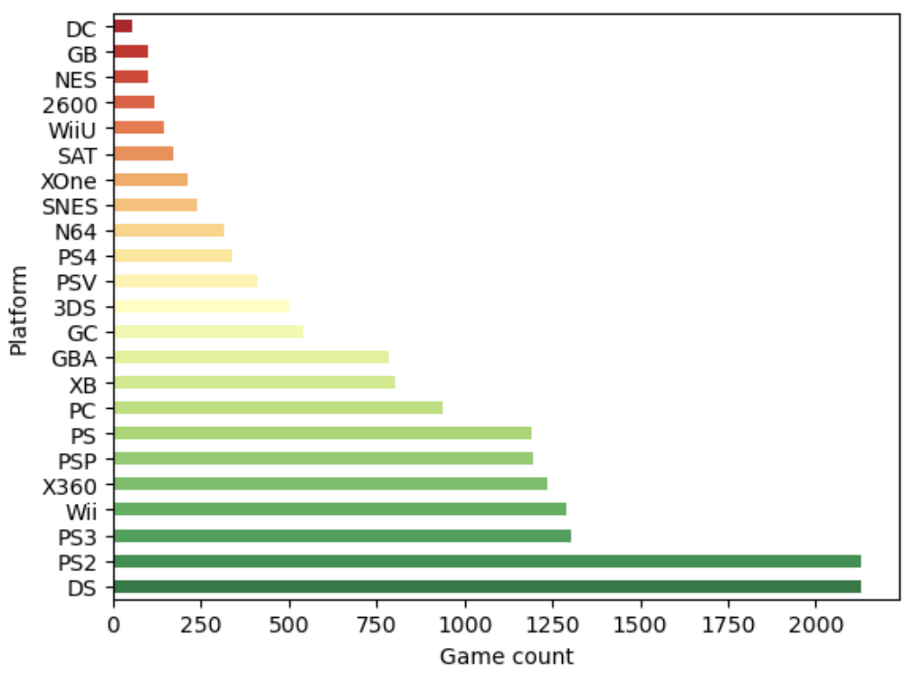
Question 2
What video game platform has the most games?
DS and PS2, with over 2000 games per platform

Slide 8
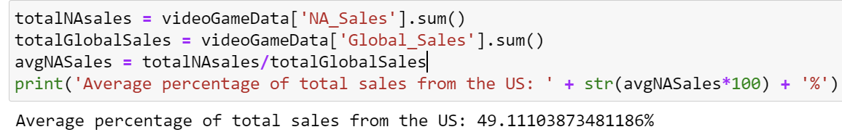
Question 3
What is the average percent of total sales which are from the US?

Slide 9
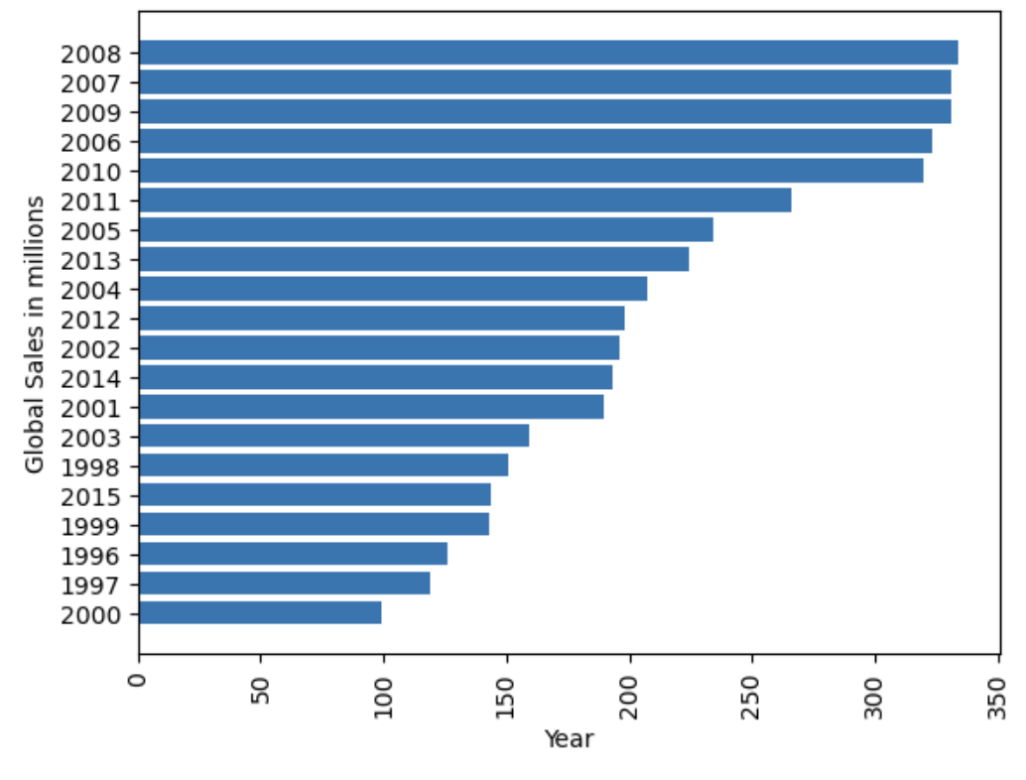
Question 4
What year had the most popular games released?
2008, with almost 700 million sales

Slide 10
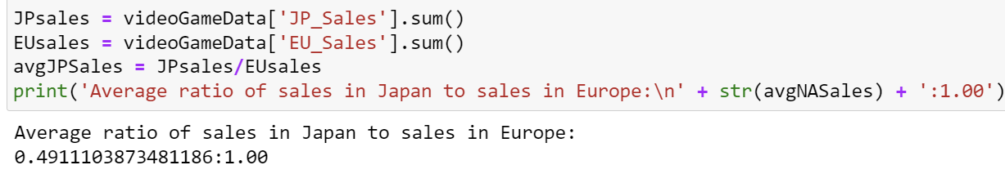
Question 5
How do Japanese sales compare to European sales on average?

Slide 11

Thank you!

